Slide 1
OOPS IN PYTHON

Slide 2
Benefits of inheritance are:
It represents real-world relationships well.
It provides the reusability of a code. We don’t have to write the same code again and again. Also, it allows us to add more features to a class without modifying it.
It is transitive in nature, which means that if class B inherits from another class A, then all the subclasses of B would automatically inherit from class A.

Slide 3
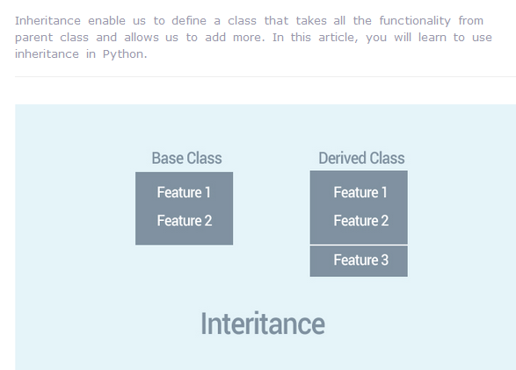

Slide 4
Instead of starting from scratch, you can create a class by deriving it from a preexisting class by listing the parent class in parentheses after the new class name.
The child class inherits the attributes of its parent class, and you can use those attributes as if they were defined in the child class. A child class can also override data members and methods from the parent.

Slide 5
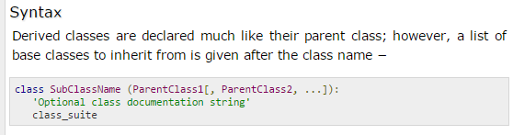
The Syntax is:

Slide 6
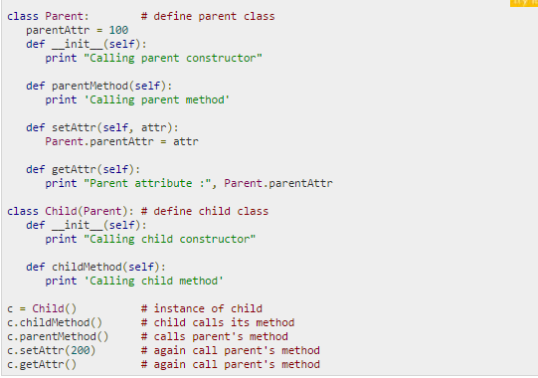

Slide 7
Data Hiding
An object's attributes may or may not be visible outside the class definition. You need to name attributes with a double underscore prefix (__x) and those attributes then are not be directly visible to outsiders.

Slide 8
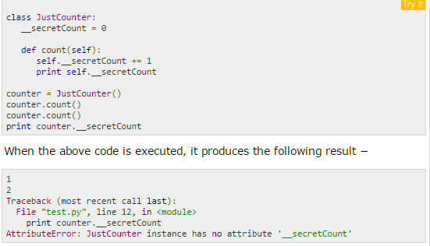
Data Hiding

Slide 9
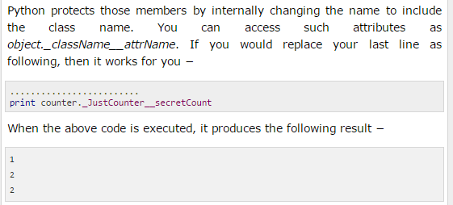

Slide 10
#@How to access private data outside a class...
class A:
def fun(self):
self.id=288
self.__accountno = 1002 # it is private data
def show(self):
print(self.id, self.__accountno)
#accountno is private will get used inside class
ob = A()
ob.fun()
ob.show()
print("public data of class is id", ob.id)
print("private data of class is accountno ", ob._A__accountno) #now it is possible to access private data outside class also
o/p is: 288 1002
public data of class is id 288
private data of class is accountno 1002

Slide 11
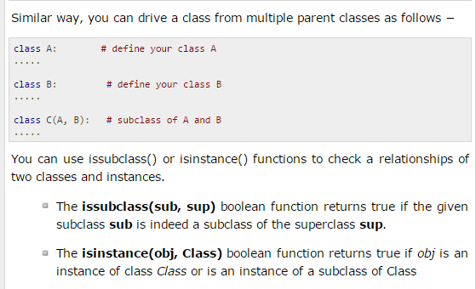

Slide 12
Overriding Methods
If sub/child class also has same named method as of its super/parent/base class then child class method will override its super/base class method. So in print, always child class method will be invoked.
You can always override your parent class methods. One reason for overriding parent's methods is because you may want to hide parent method contents.
But using super(). with method name, we can print parent class method also.

Slide 13
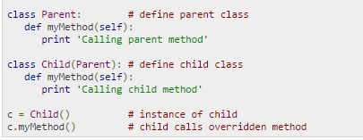
Example of overridden method as parent class method is overridden by child class method because name of both is same

Slide 14
class A:
def Bio(self):
print("I am in Python")
class B(A):
def Hobbies(self):
print("I Love programming")
class C(B):
def marks(self):
print("my scoring is 92%")
ob = C()
ob.Bio()
ob.Hobbies()
ob.marks()

Slide 15
# avoid override using super() when both classes have same named method
class A:
def show(self):
print("BASE class")
class B(A):
def show(self):
print("CHILD class")
super().show() # it is show() of base/super class
ob = B()
ob.show() # will alwayssss invoke show() method of sub/child class
#A is base/super/parent class. B is child/sub/derive class
#super().show() will be mentioned in derive class. now, parent class method will be printed also
o/p:
CHILD class
BASE class

Slide 16
How to call super class construcor in sub class use super()
super().__init__()
  mention it inside constructor of sub class.
  Now:
  When object of sub class will be created then automatically, constructor body of super class will get print.

Slide 17
# invoke base class constructor in inheritance
class A:
def __init__(self):
print("BASE class constructor but call me via sub class as super().__init__() in sub class ")
class B(A):
def __init__(self):
super().__init__()
print("CHILD class constructor")
ob = B()
#A is base/super/parent class. B is child/sub/derive class
o/p:
BASE class constructor but call me via sub class as super().__init__() in sub class
CHILD class constructor

Slide 18
#Multilevel Inheritance and print methods of base classes also.
class A:
def fun(self):
print ('A')
class B(A):
def fun(self):
super().fun()
print ('B')
class C(B):
def fun(self):
super().fun()
print ('C')
d = C()
d.fun()
A
B
C

Slide 19
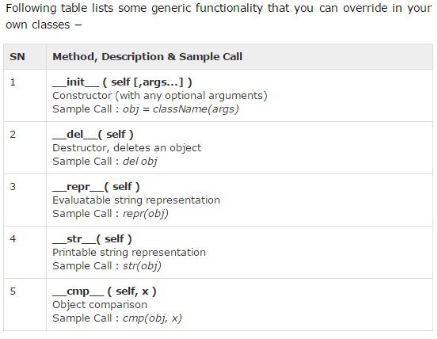
Base Overloading Methods

Slide 20
Function overloading
Function overloading is the ability to have multiple functions with the same name but with different signatures/implementations. When an overloaded function fn is called, the runtime first evaluates the arguments/parameters passed to the function call and judging by this invokes the corresponding implementation
In python, When we define multiple functions with the same name, the later one always overrides the prior.

Slide 21
Function overloading
class A:
def sum(self, a, b,c):
print("First method:",a+b+c)
def sum(self, a, b):
print("Second method:", a + b)
obj=A()
obj.sum(10,10)
#no error now as sum with 2 parameters override
#sum with 3 parameters

Slide 22
Function overloading
class A:
def sum(self, a, b,c):
print("First method:",a+b+c)
def sum(self, a, b):
print("Second method:", a + b)
obj=A()
obj.sum(10,10,10)
#error now as sum with 2 parameters override
#sum with 3 parameters but we passed 3 parameters 10,10,10

Slide 23
Function overloading
class A:
def sum(self, a, b):
print("Second method:", a + b)
def sum(self, a, b,c):
print("First method:",a+b+c)
obj=A()
obj.sum(10,10,10)
#no error now as sum with 3 parameters override
#sum with 2 parameters

Slide 24
Make parameter None to do function overloading
#The None keyword means no value at all.
class A:
def area(self, x=None, y=None):
if x!=None and y !=None:
return x*y
elif x!=None:
return x*x
else:
return 0
obj = A()
print(obj.area())
print(obj.area(5))
print(obj.area(3,2))
o/p:
0
25
6

Slide 25
Operator Overloading in Python

Slide 26
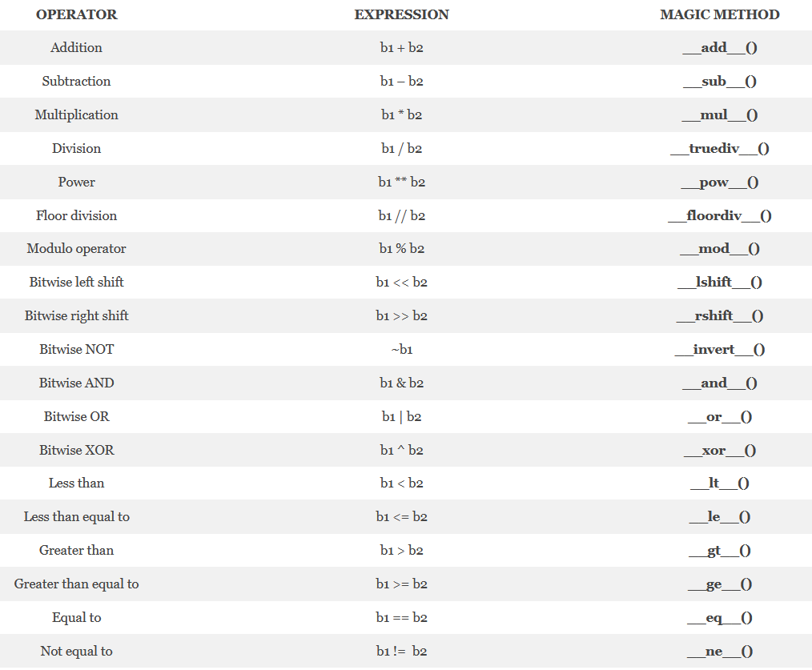

Slide 27
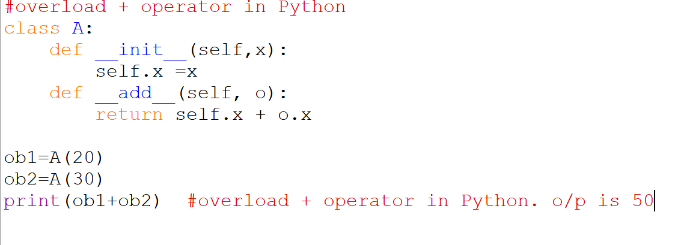
+ is overloaded as
__add__(self, other)

Slide 28
Operator Overloading in Python
Suppose you have created a Vector class to represent two-dimensional vectors, what happens when you use the plus operator to add them?
You could, however, define the __add__() method in your class to perform vector addition and then the plus operator would behave as per expectation

Slide 29
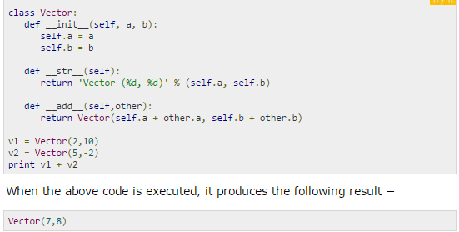
Example of overload + operator

Slide 30
#overload operators in Python
class A:
def __init__(self, x):
self.xx=x
print("operator overloading")
def __floordiv__(self, i):
return self.xx//i.xx
def __truediv__(self, i):
return self.xx/i.xx
def __ne__(self, i):
return self.xx != i.xx
n=[59,10]
ob1 = A( n[0])
ob2 = A(n[1])
print(n[0],"//",n[1],"= ", ob1 // ob2)
print(n[0],"/",n[1],"= ",ob1 / ob2)
print(n[0],"!=",n[1]," ", ob1 != ob2)

Slide 31
class A:
def show(self, x):
self.x=x
print("Various elements are",self.x)
a=[]
n=5
print("Enter ",n," elements")
for i in range(n):
n1=int(input())
a.append(n1) # here a is a collection of n elements
ob=A()
ob.show(a) # now send all elements inside class

Slide 32
Questions1(Account Class)
Design the class name account that contains:
  A private id for account
  A private balance for account
  A private intrate for annual interest rate
  A constructor that creates an account with specified id, initial balance and interest rate.
  A method name getmonthlyinterestrate() that return monthly interest rate.
  A method name checkbalance() that return balance amount from the account.
  A method name withdraw() that withdraws a specified amount from the account.
  A method name deposite() that deposits a specified amount to the account.
  == Create 10 accounts with initial balance 100 and rate of interest 4%.
  ==The system prompts the user to enter account ID, if it is correct open a main menu having choices
  1. Check balance, 2. withdraw, 3. deposit and 4. exit.

